Slide 1

Predicting MLB Playoff Teams
Bradley Hepburn
Mololuwa Fatoki
Raul Doria

Slide 2
Introduction
The Champions of the 2023 Major League Baseball Series is…
(Place your bets)

Slide 3
Project Objectives
To determine which Major League Baseball teams would make it to the playoffs.
Develop an optimized neural network model for predictive analysis
Visualization and Interpretation of Major League Baseball Data
Comparative Analysis of different Machine Learning models
Sell our model to Barstool Sportsbook, BetMGM and Ceasers for millions of dollars.

Slide 4
Major League Baseball DATASET
Dataset Description
Variables and Features - Home Runs, At Bats, Stolen Bases, Defensive Efficiency, Earned Runs etc.
Data Source

Slide 5
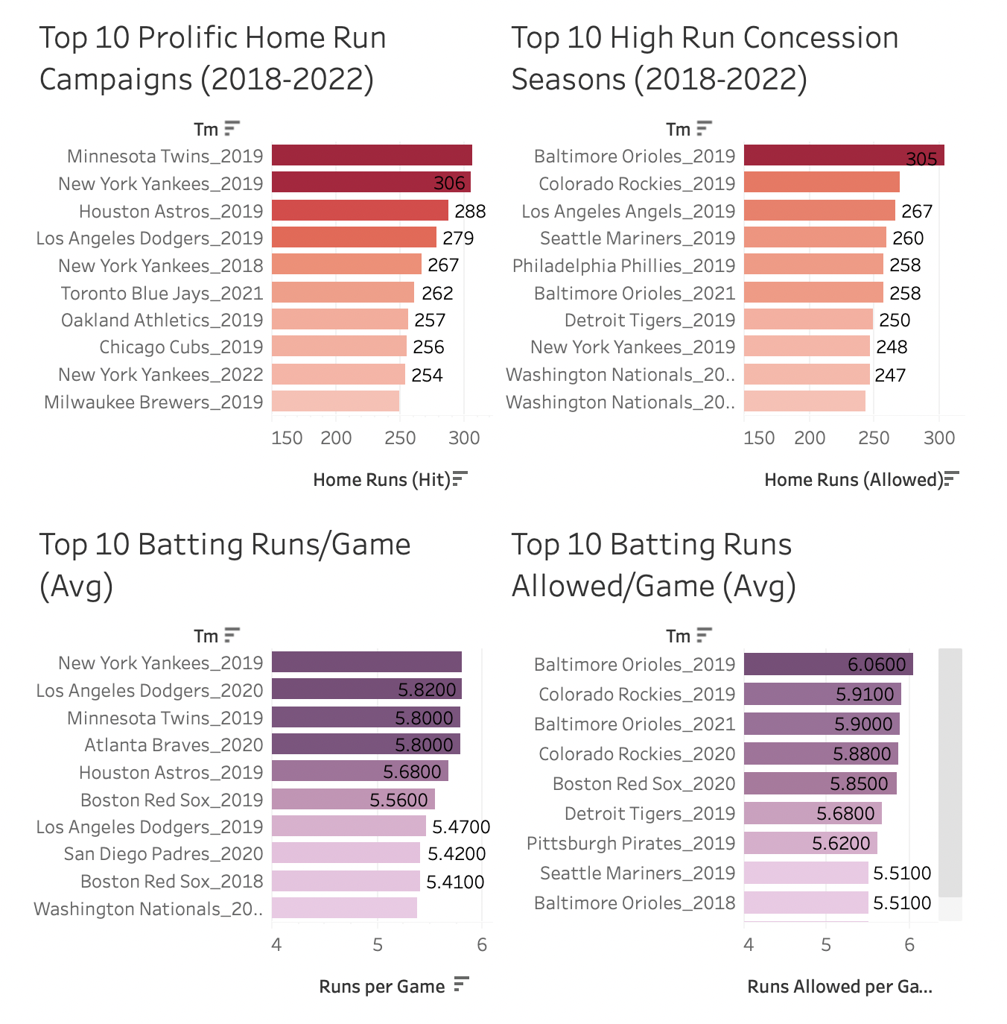
EXPLORATORY DATA ANALYSIS

Slide 6
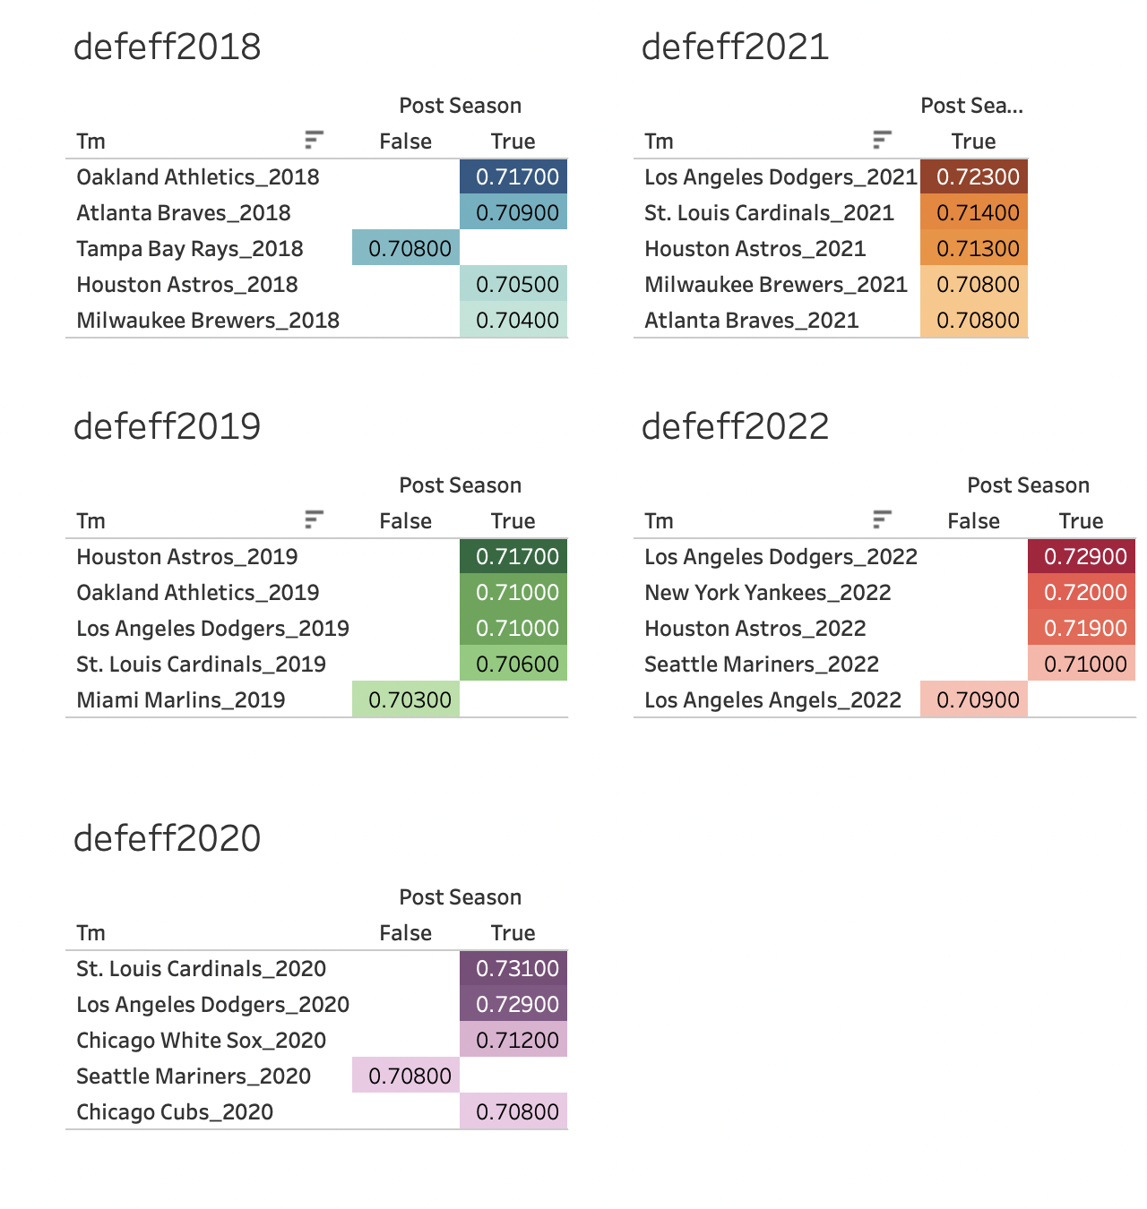
EXPLORATORY DATA ANALYSIS
Correlation of Defensive Efficiency on Post Season Play-off Qualification
Trends

Slide 7
Feature Engineering
Feature Selection
01
Process of feature engineering - Transformations and new variables created.
02
Importance of selecting meaningful features for accurate predictions.
03
Lagged Variables
1. Player batting average
2. Pitcher earned run average
04

Slide 8

Neural Network Model - TRAINING AND EVALUATION
Overview of the neural network model used for the predictive element.
Architecture and key components of the model
The process of training and optimizing the neural network model
Metrics used to assess the model's performance

Slide 9











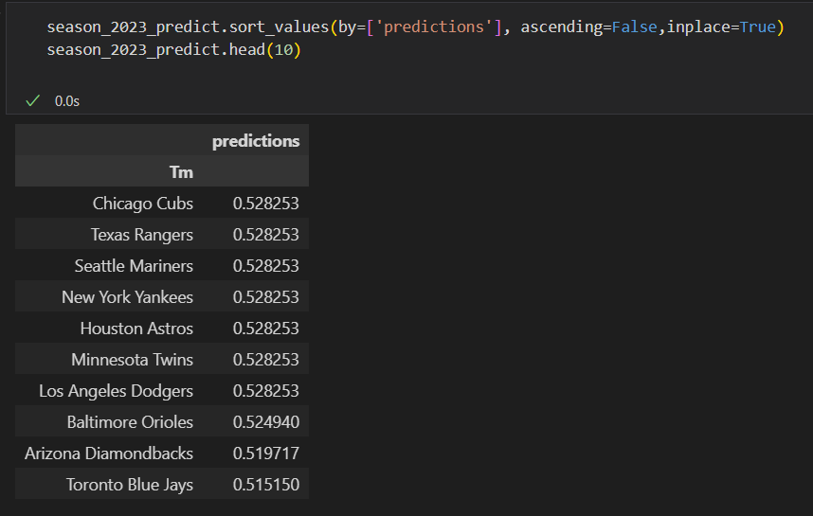
Predictive Performance
(Model performance in predicting 2023 MLB playoff Teams)

Slide 10
LIMITATIONS AND FUTURE WORK
Limitations or challenges encountered during the project
Areas for improvement and future research
Additional data sources - Enhance the accuracy of predictions

Slide 11
Conclusion

Slide 12

Questions & Answers

